Slide 1
Module 5
The k-means clustering algorithm, Using distance to assign and update clusters, Choosing number of clusters.

Slide 2
Clustering
Clustering or cluster analysis is the task of grouping a set of objects in such a way that objects in the same group (called a cluster) are more similar (in some sense) to each other than to those in other groups (clusters).
Clustering is a main task of exploratory data mining and used in many fields, including machine learning, pattern recognition, image analysis, information retrieval, bioinformatics, data compression, and computer graphics.
Clustering creates new data. Unlabeled examples are given a cluster label and inferred entirely from the relationships within the data.
For this reason, clustering task referred to as unsupervised classification because, in a sense, this is classifying unlabeled examples.
That’s why Clustering is different from the classification, numeric prediction, and pattern detection tasks.

Slide 3
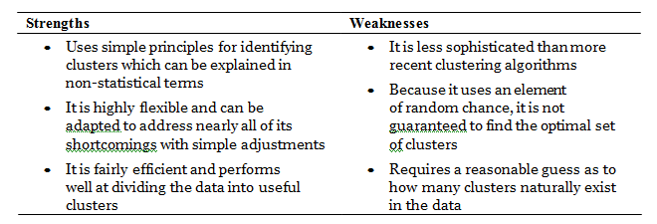
The k-means clustering algorithm
The k-means clustering algorithm is one of the simplest unsupervised learning algorithms for solving the clustering problem.
Strengths & Weaknesses

Slide 4

Using distance to assign and update clusters
if n indicates the number of features, the formula for Euclidean distance between example x and example y is as follows:

Slide 5
Choosing the appropriate number of clusters
Sometimes the number of clusters is dictated by business requirements or the motivation for the analysis.
Without any a priori knowledge at all, one rule of thumb suggests setting k equal to the square root of (n / 2), where n is the number of examples in the dataset.
A technique known as the elbow method attempts to gauge how the homogeneity or heterogeneity within the clusters changes for various values of k.
As illustrated in the following figures, the homogeneity within clusters is expected to increase as additional clusters are added; similarly, heterogeneity will also continue to decrease with more clusters.
Because you could continue to see improvements until each example is in its own cluster, the goal is not to maximize homogeneity or minimize heterogeneity, but rather to find k such that there are diminishing returns beyond that point. This value of k is known as the elbow point, because it looks like an elbow.

Slide 6
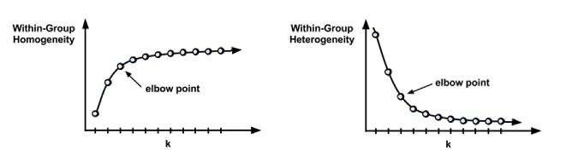

Slide 7
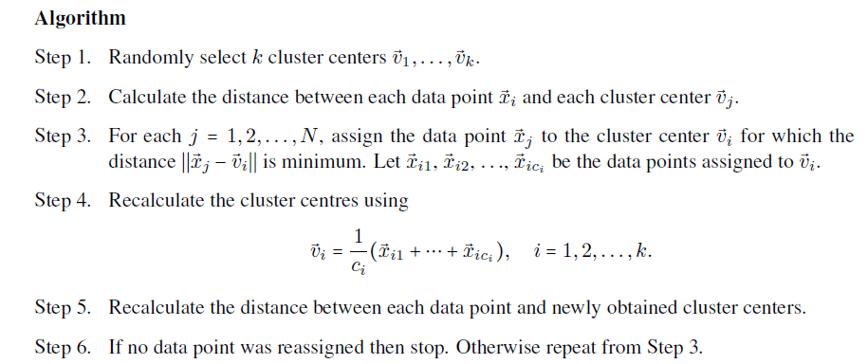

Slide 8
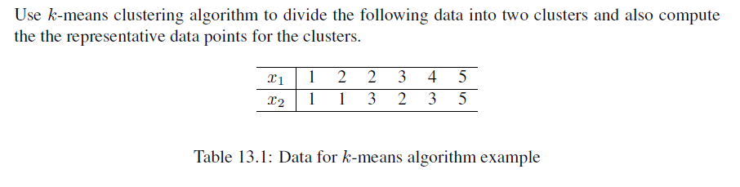

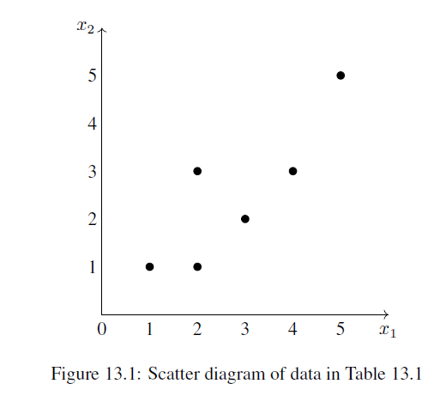
Problem

Slide 9
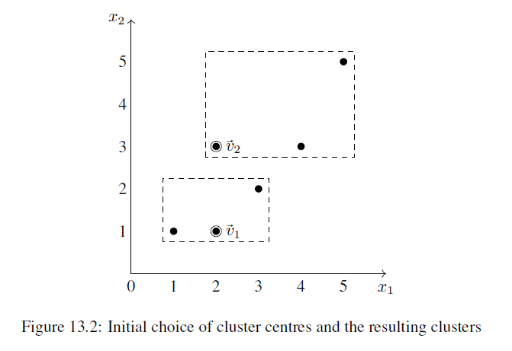

Slide 10
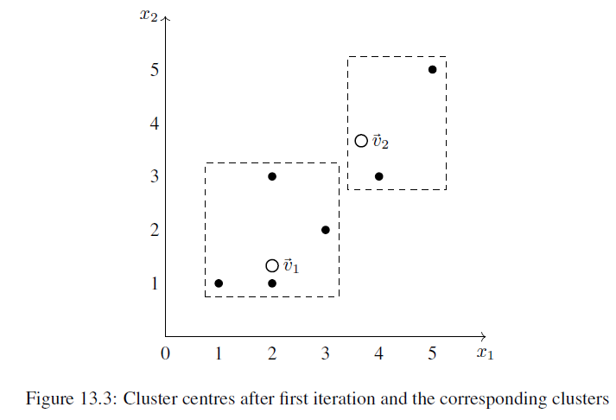

Slide 11
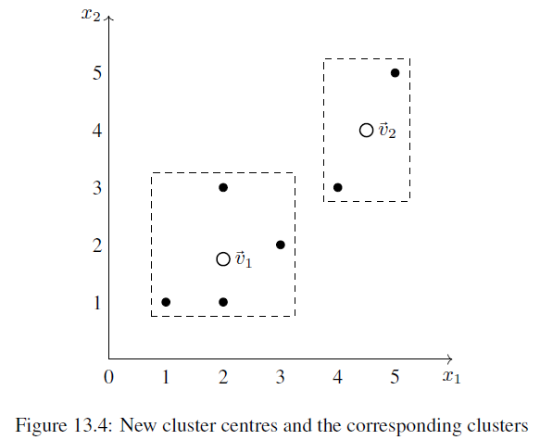

Slide 12
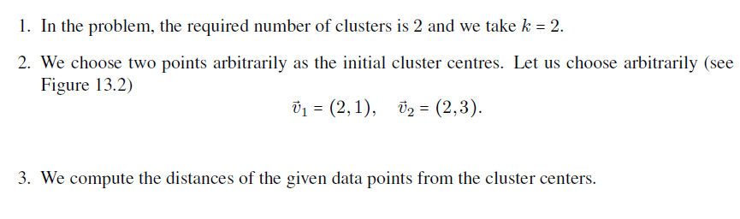
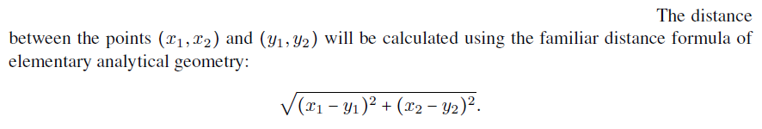
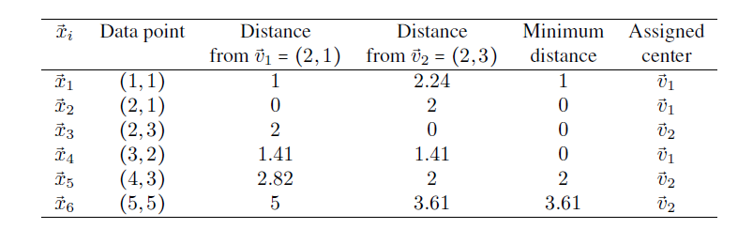

Slide 13
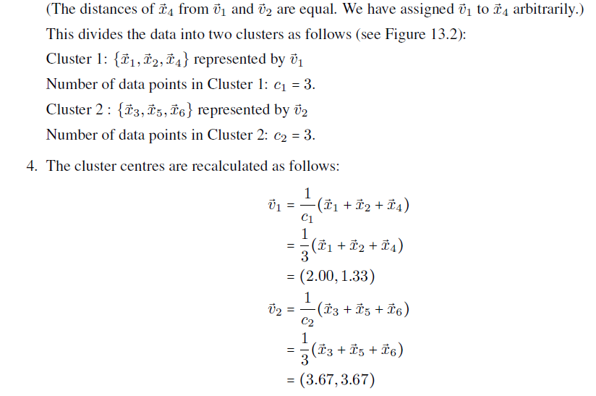

Slide 14
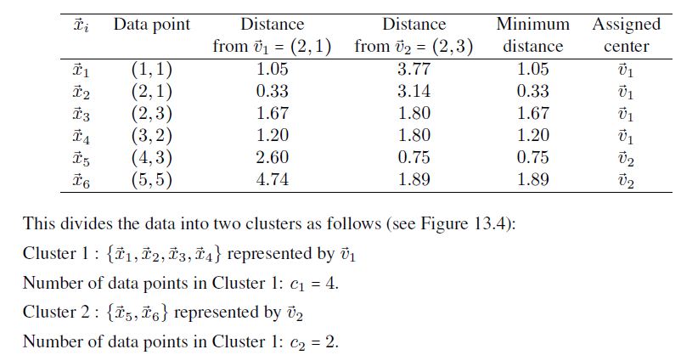
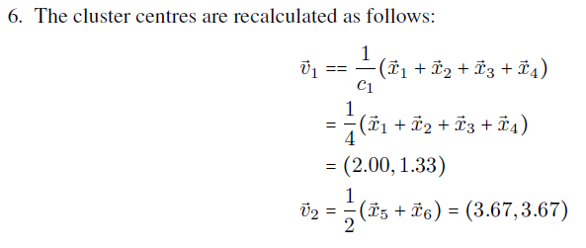

Slide 15

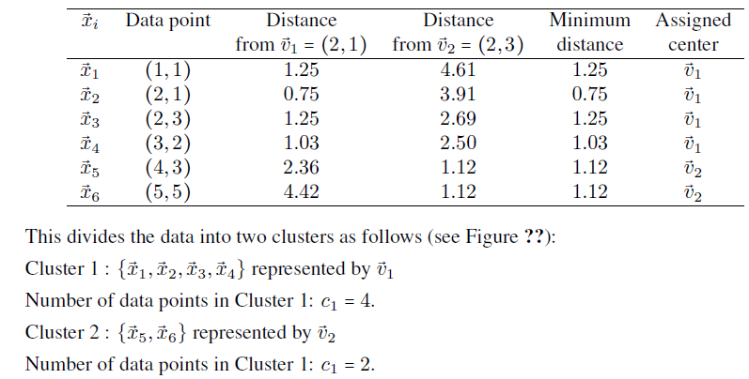

Slide 16
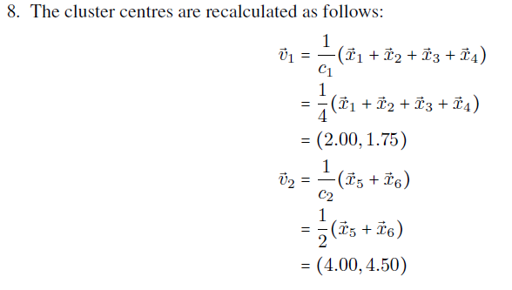
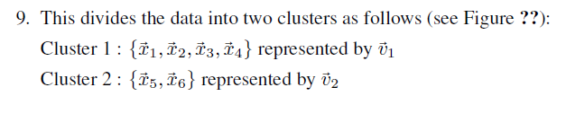

Slide 17
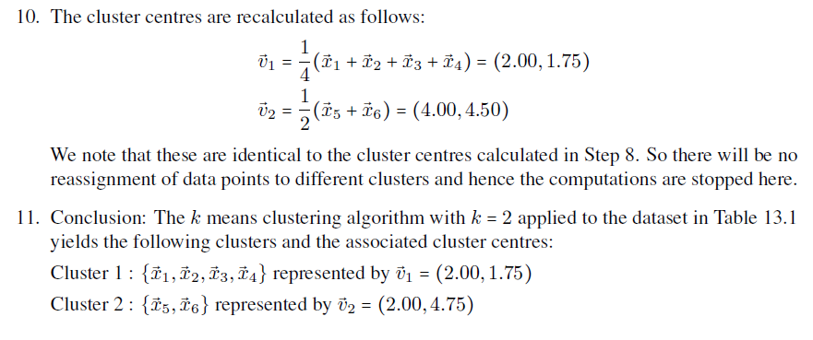

Slide 18
Evaluating model performance
There are three main types of data that are used to evaluate a classifier:
  Actual class values
  Predicted class values
  Estimated probability of the prediction
The actual class values come directly from the target feature in the test dataset.
Predicted class values are obtained using the model.

Slide 19
Evaluation Measures
Confusion Matrices

Slide 20
Confusion Matrices

